Slide 1


Recognizing Handwritten Alphabets
Team Members
Tella Krishna Prasad
Md Abdul Shoaib

Slide 2
PROBLEM STATEMENT
The Recognizing Handwritten Alphabets is to develop an algorithm that can accurately identify and classify handwritten alphabets from a given image, despite variations in writing style, font, size. The algorithm should be lightweight, robust to noise and distortions, and achieve high accuracy with low latency, making it suitable for real-world applications such as document processing, signature verification, and accessibility for visually impaired individuals.

Slide 3
Objective
The Recognizing Handwritten Alphabets is to create an accurate and efficient machine learning model that can classify handwritten alphabets into one of the 26 categories (A-Z) based on a given input image. The model should be able to handle variations in writing style, font, size and in the image. The model should be optimized for real-world applications, achieving high accuracy and low latency, and providing a user-friendly interface for easy integration into various systems such as document processing, signature verification, and accessibility tools for visually impaired individuals.

Slide 4
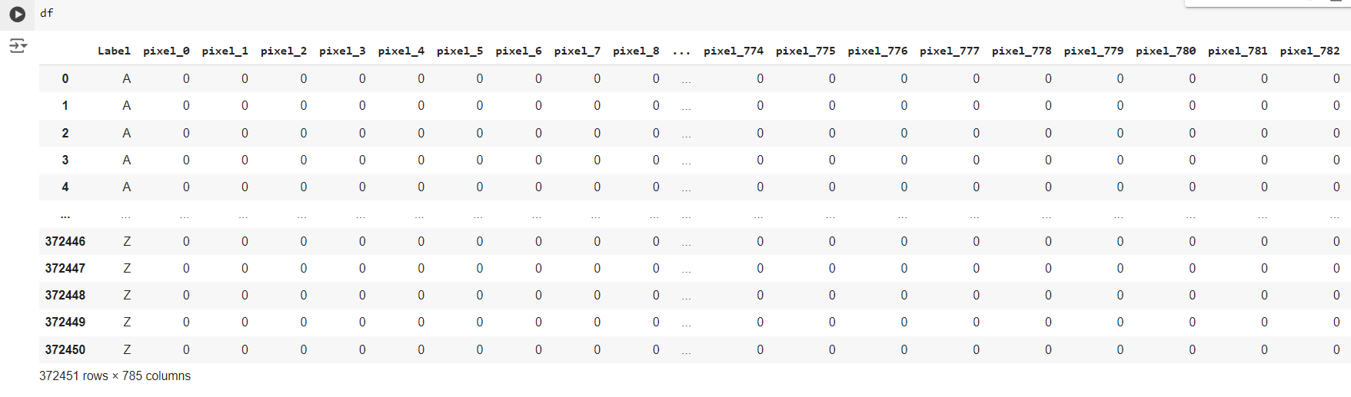
Data Cleaning Process

Slide 5
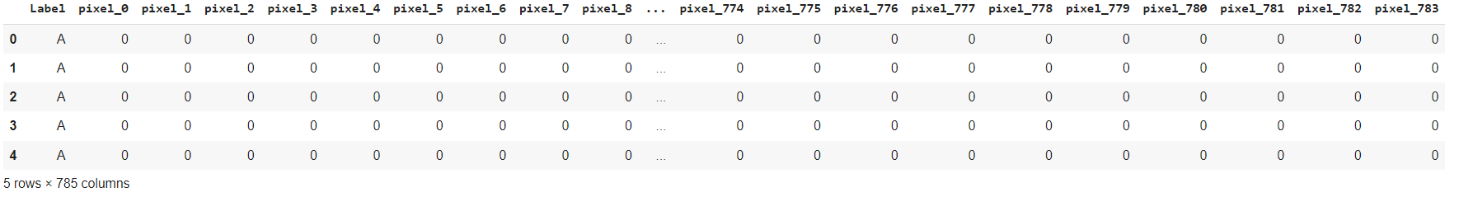
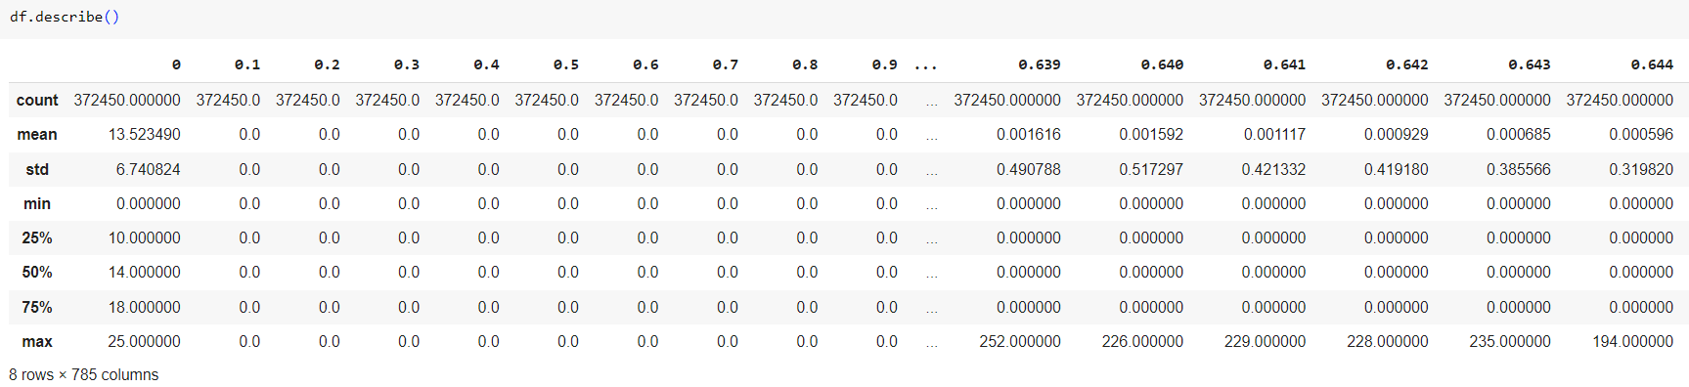
Describe :

Slide 6
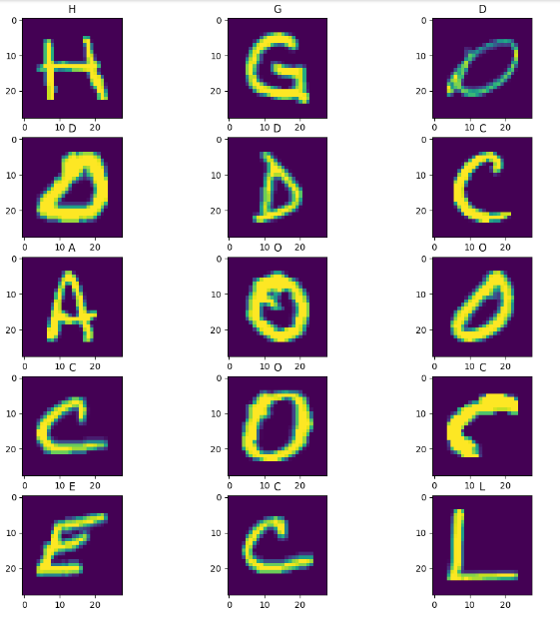
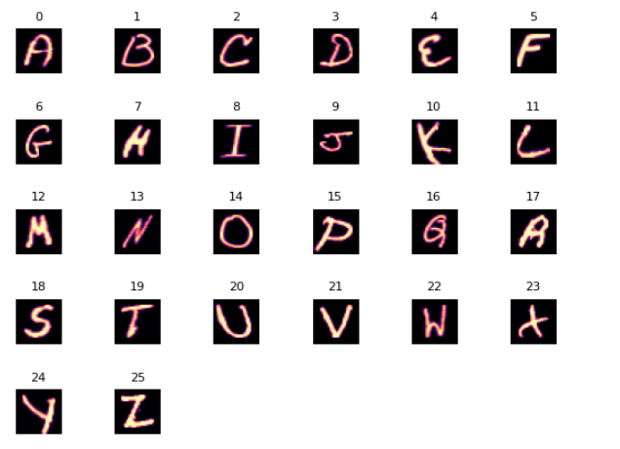
The above image shows the data we got from the DataFrame.

Slide 7
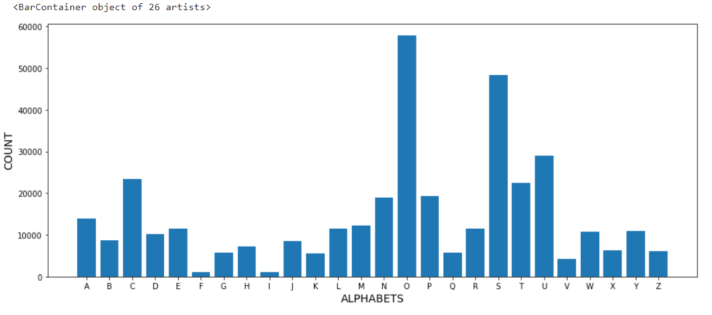
The above Graph represent the count of the each alphabets in the Data Frame.

Slide 8
Models
Logistic Regression:
Logistic regression is a statistical method that is used for building machine learning models where the dependent variable is dichotomous: i.e. binary. Logistic regression is used to describe data and the relationship between one dependent variable and one or more independent variables.
Decision Tree Classifier:
A decision tree is a non-parametric supervised learning algorithm, which is utilized for both classification and regression tasks. It has a hierarchical, tree structure, which consists of a root node, branches, internal nodes and leaf nodes.
Random Forest Classifier:
Random forest is a commonly-used machine learning algorithm, trademarked by Leo Bierman and Adele Cutler, that combines the output of multiple decision trees to reach a single result. Its ease of use and flexibility have fueled its adoption, as it handles both classification and regression problems.
Accuracy :
S No | Algorithm Name | Metric Score
1 | Logistic Regression | 0.877761
3 | Decision Tree Classifier | 0.947279
4 | Random Forest Classifier | 0.985490

Slide 9
CONCLUSION
Based on the Accuracy metrics, the best model for the classification problem appears to be Logistic Regression model. Although all the other models had similar accuracy scores, Logistic Regression model had the highest Accuracy.
While Logistic Regression model had a good accuracy score of 0.985490. Therefore, based on the metrics evaluated Logistic Regression model appears to be the best model for this classification problem.

Slide 10


